Slide 1
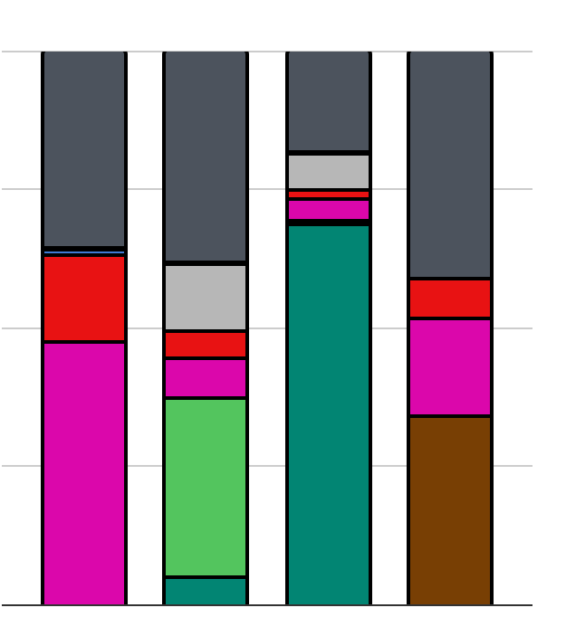
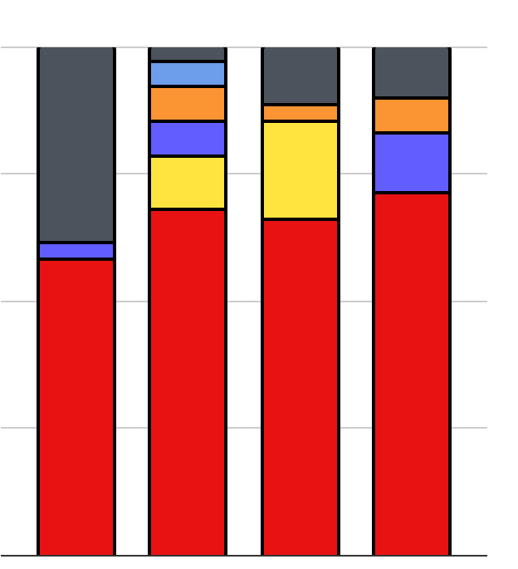
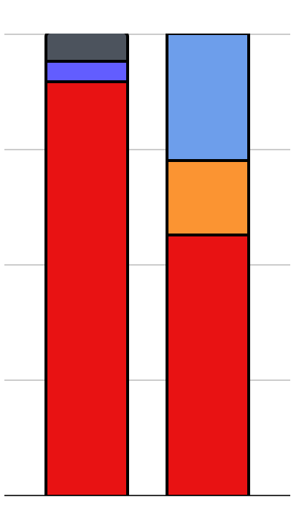
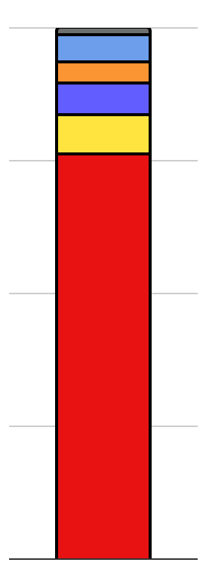
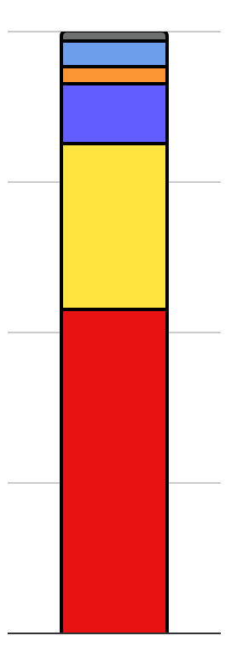
The battery mineral supply chain is geographically concentrated
Material Processing and Refining
Cathode Material Production
Battery & Cells
Mining
EVs
100%
Other
KOR
USA
Other
Other
USA
75%
EU
JPN
EU
RUS
50%
CHN
Share of Production
CHN
AUS
CHN
DRC.
CHN
CHN
CHN
CHN
CHN
CHN
25%
AUS
IDN
ZAF
0%
Li
Ni
Co
Mn
Li
Ni
Co
Mn*
LFP
NMC
All Chemistries
Li: Lithium; Ni: Nickel; Co: Cobalt; Mn: Manganese*. Adapted from IEA 2022, USGS 2022, and Sun et al. 2021
Abbreviations: CHN: China, AUS: Australia, IDN: Indonesia, RUS: Russia, DRC: Democratic Republic of the Congo, KOR: Republic of Korea (South Korea), JPN: Japan, USA: United States; EU: European Union; Other: any other country not named here
*Electrolytic Manganese Dioxide only
Downstream
Notes:
Verbal:
supply chain risk due to geopolitical or natural disruptions
Notes/sources:
https://iea.blob.core.windows.net/assets/4eb8c252-76b1-4710-8f5e-867e751c8dda/GlobalSupplyChainsofEVBatteries.pdf

Slide 2
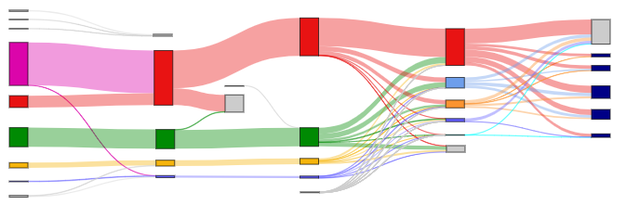
Lithium (unsharpened/unlabeled)

Slide 3
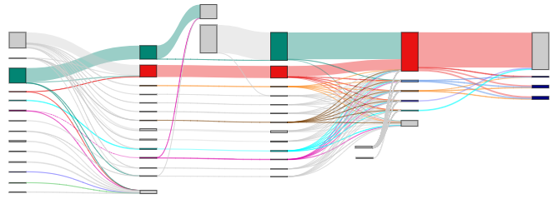
Cobalt (unsharpened/unlabeled)

Slide 4
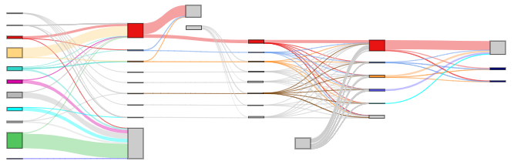
Nickel (unsharpened/unlabeled)

Slide 5
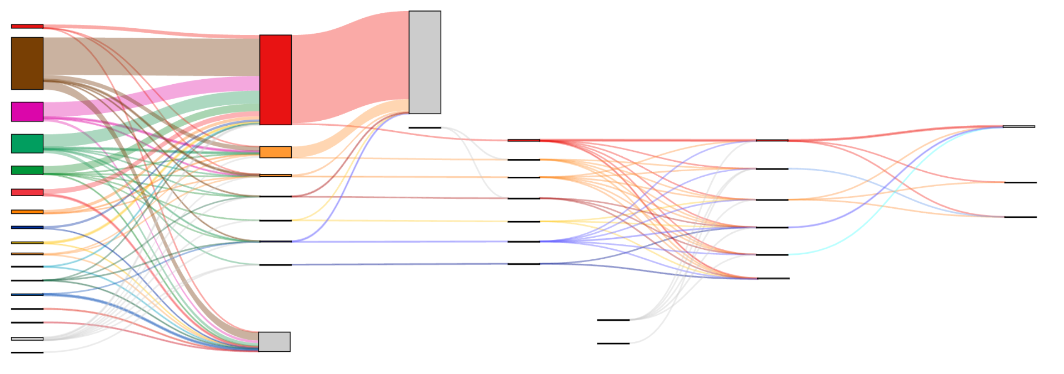
Manganese (unlabeled)

Slide 6
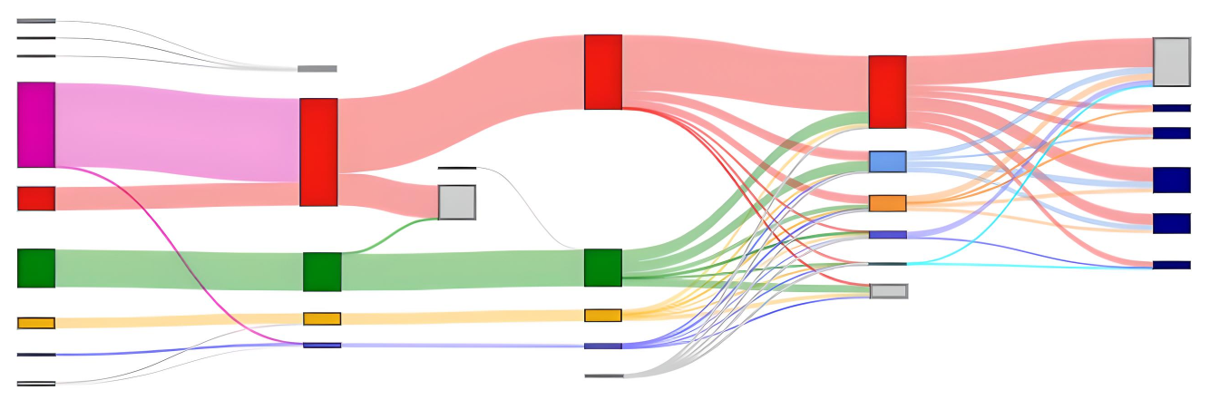
Lithium
Raw Material
Refined Material
Cathode Production
Mining & Extraction
Refining & Processing
Post-Trade
Post-Trade
Manufacturing
Brazil
Portugal
Zimbabwe
Trade to countries with no battery-related refining, or raw materials not accounted for in trade
Non-Cathode Products
China
China
LMO
Australia
LCO
China
South Korea
Unaccounted-for additional refining production
NCA
China
Raw materials not accounted for in battery-related refining production
Japan
USA
NMC
Chile
Chile
Chile
Canada
LFP
Trade to non-cathode producing countries, or refined materials not accounted for in trade
EV Cathodes
Argentina
Argentina
Argentina
Scale
USA
USA
USA
Trade from countries with no refining
≈ 9 thousand
metric tons
contained Lithium
Lithium
Missing extracted material used in refining step
Trade
Processing
Trade
Processing

Slide 7
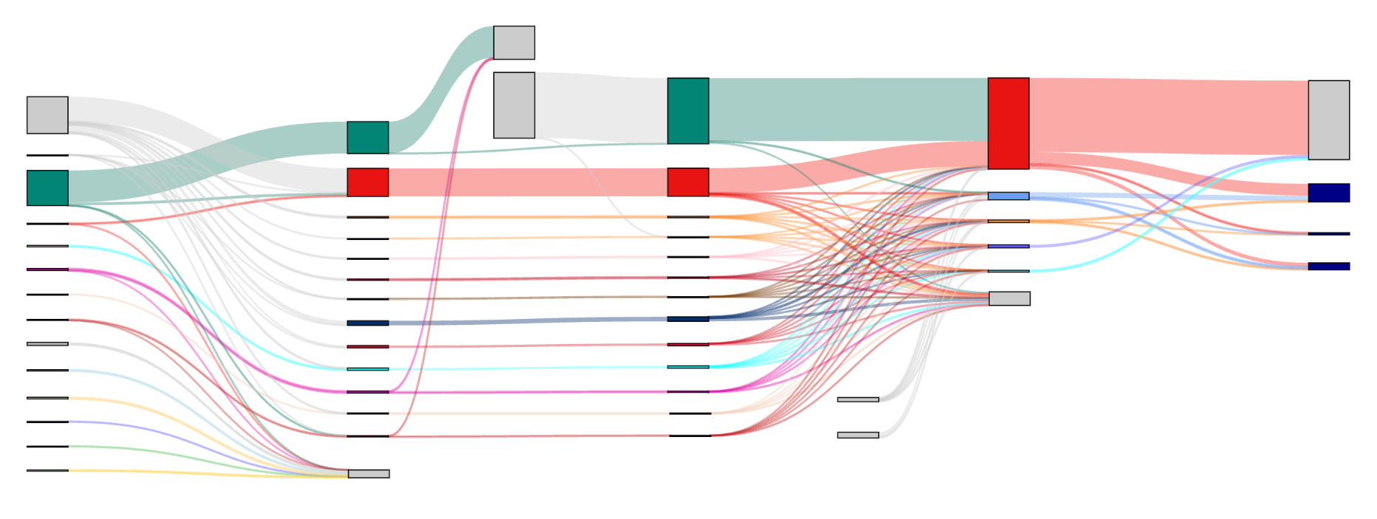
Raw Material
Refined Material
Cathode Production
Mining & Extraction
Refining & Processing
Post-Trade
Post-Trade
Manufacturing
Raw materials not accounted for in battery-related refining production
a) Cobalt
Unaccounted-for additional refining production
Missing extracted material used in refining step
Non-Cathode Products
DRC
China
Trade from countries with no mining
Dem. Rep. of Congo
China
South Korea
LCO
China
Japan
Japan
Canada
India
USA
NCA
Australia
Zambia
Canada
NMC
Madagascar
Norway
South Africa
Trade to non-cathode producing countries, or refined materials not accounted for in trade
EV Cathodes
Morocco
Finland
Russia
Belgium
Cuba
Canada
Philippines
Australia
Trade from countries with no refining
Scale
USA
Madagascar
Indonesia
Morocco
Missing refined material used in cathode production
34 thousand ≈ metric tons
contained
Cobalt
Papua New Guinea
Trade to countries with no battery-related refining, or raw materials not accounted for in trade
Trade
Processing
Trade
Processing

Slide 8
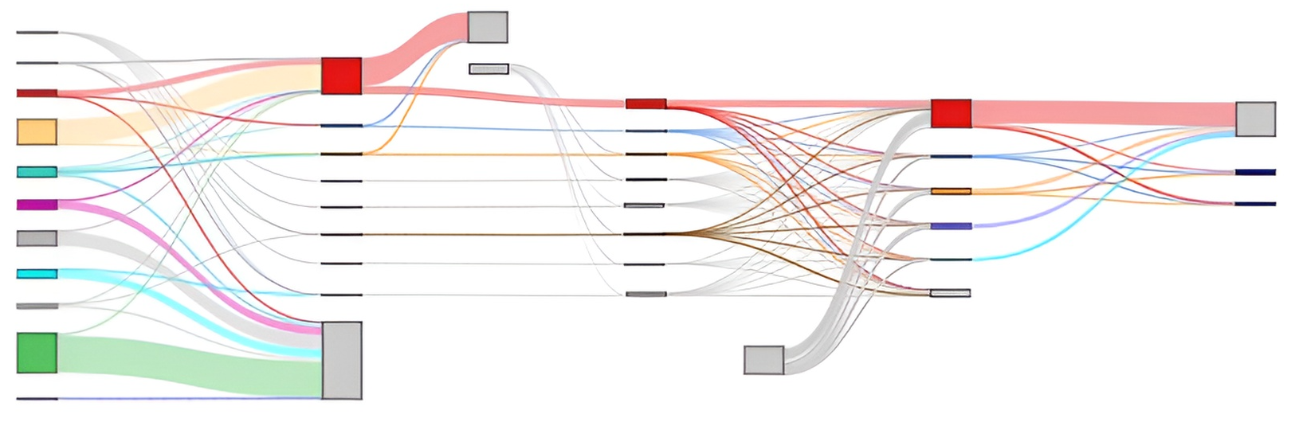
Nickel
Raw Material
Refined Material
Cathode Production
Mining & Extraction
Refining & Processing
Post-Trade
Post-Trade
Manufacturing
Missing extracted material used in refining step
Raw materials not accounted for in battery-related refining production
b) Nickel
Trade from countries with no mining
China
Unaccounted-for additional refining production
China
Non-Cathode Products
South Korea
China
Philippines
Japan
South Korea
New Caledonia (France)
United Kingdom
NCA
Japan
NMC
Australia
Norway
Russia
South Africa
USA
EV Cathodes
France
Canada
Canada
Brazil
Finland
Trade to non-cathode producing countries, or refined materials not accounted for in trade
Scale
Indonesia
Trade to countries with no battery- related refining, or raw materials not accounted for in trade
Trade from countries with no refining
280 thousand ≈ metric tons
contained
Nickel
USA

Slide 9
Manganese
Raw Material
Refined Material
Cathode Production
Mining & Extraction
Refining & Processing
Post-Trade
Post-Trade
Manufacturing
China
c) Manganese
South Africa
Raw materials not accounted for in battery-related refining production
China
Australia
Non-Cathode Products
Unaccounted-for additional refining production
China
Gabon
India
Brazil
Japan
South Korea
Ghana
LMO
Spain
Japan
Côte d’Ivoire
Colombia
NMC
USA
USA
EV Cathodes
Greece
Canada
Trade from countries with no refining
Trade to non-cathode producing countries, or refined materials not accounted for in trade
Scale
1.1 million ≈ metric tons
contained
Manganese
Trade from countries with no mining
Trade to countries with no battery- related refining, or raw materials not accounted for in trade
Missing refined material used in cathode production
Missing extracted material used in refining step
Trade
Processing
Trade
Processing

Slide 10
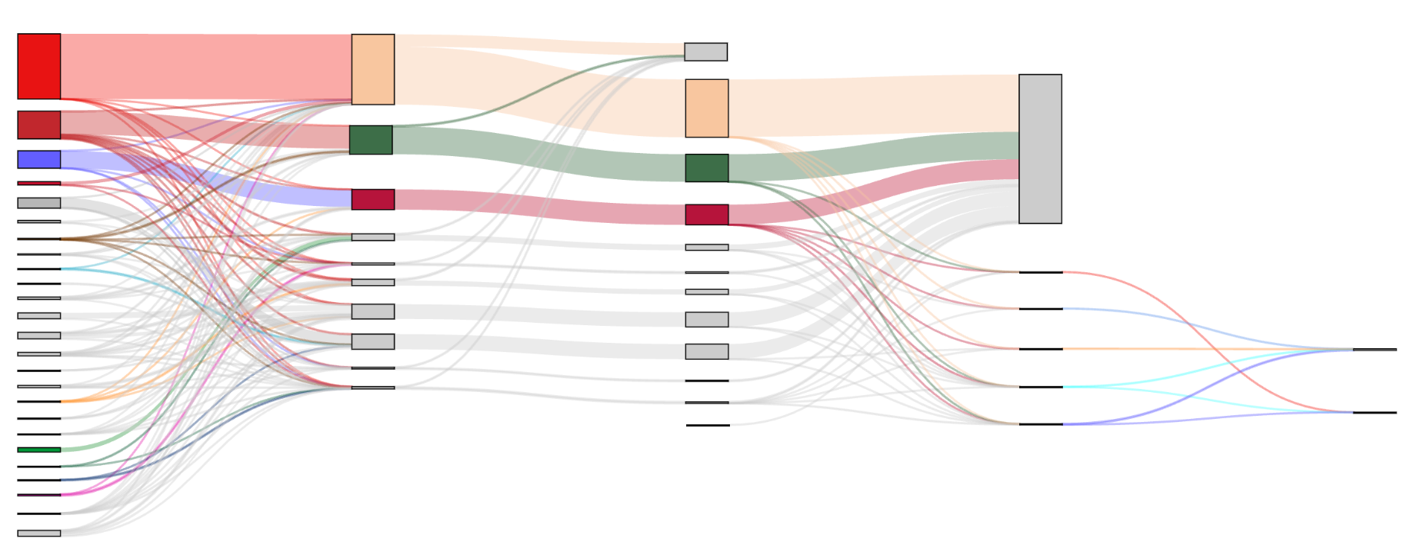
Raw Material
Refined Material
Cathode Production
Mining & Extraction
Refining & Processing
Post-Trade
Post-Trade
Manufacturing
Raw materials not accounted for in battery- related refining production
Phosphorus
China
East Asia
Trade to non- cathode producing countries, refined materials not accounted for in trade, or domestic production not counted toward EV cathode production (27.1M mt)
Morocco
Africa
USA
Vietnam
Scale
Russia
North America
4.3 million ≈ metric tons
contained
Phosphorus
Latin America
Oceania
China
(15.7K mt of demand)
South Asia
Saudi Arabia
West Asia
South Korea
(33.9K mt imported)
Leftover Trade Not Used for
Cathode Products
Jordan
East Europe & Central Asia
Japan
(32.4K mt imported)
Central Europe
West Europe
Canada
(46.4K mt imported)
Missing refined material used in cathode production not accounted for by trade
USA
(109K mt imported)
LFP (17.5K mt)
EV Cathodes
Trade from countries with no mining
Missing extracted material used in refining step
Trade
Processing
Trade
Processing

Slide 11
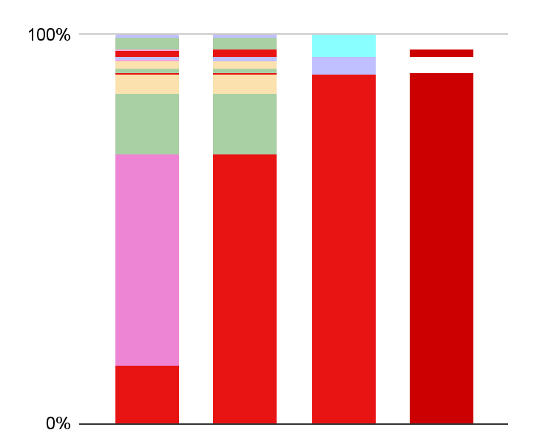
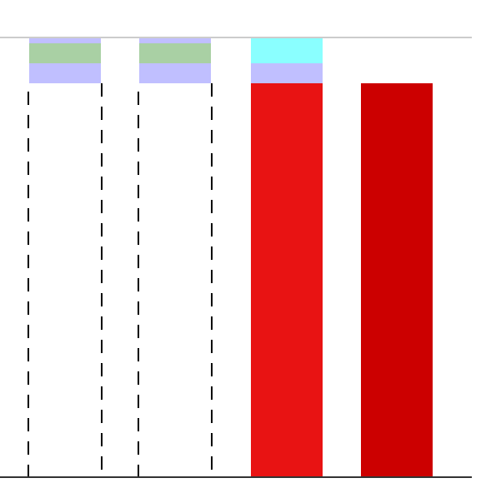
a) Base (Proportional) Case - LFP
b) Optimistic (Minimum) Case - LFP
Li Mining:
+0% CHN
Li Refining: +2% CHN
LFP Cathode: 90% CHN
Total: 92% CHN
Li Mining:
+0% CHN
Li Refining: +0% CHN
LFP Cathode: 90% CHN
Total: 90% CHN
CAN
CAN
USA
USA
ARG
ARG
CHL
CHL
LFP-Li
Supply that involves CHN
Supply that involves CHN
CHN
AUS
CHN
CHN
CHN

Slide 12
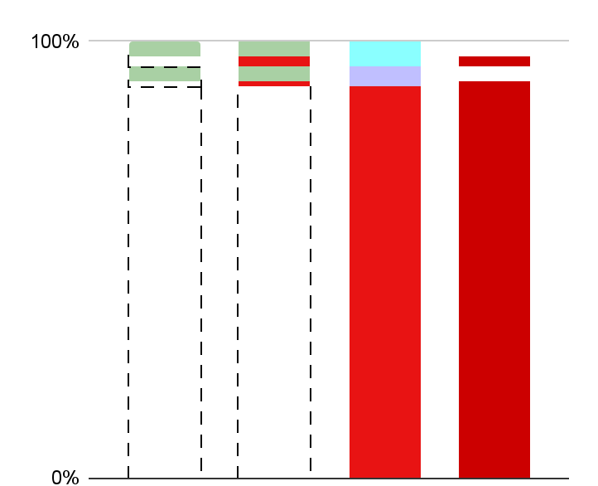
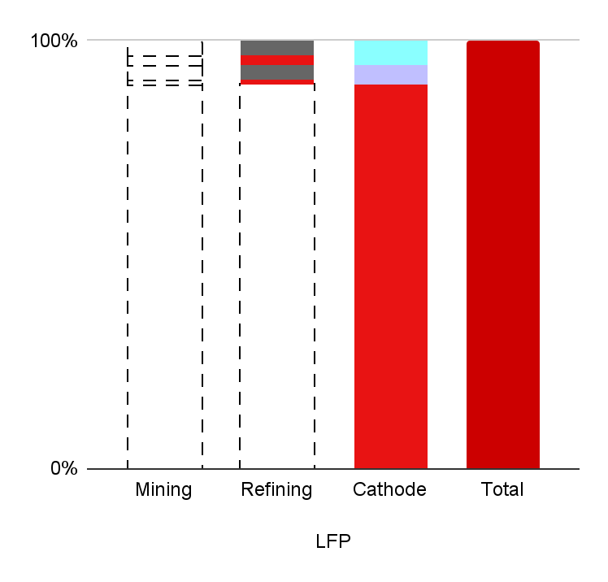
c) Pessimistic (Maximum) Case A - LFP*
d) Pessimistic (Maximum) Case B - LFP**
Li Mining:
+0% CHN
Li Refining: +3% CHN
LFP Cathode: +90% CHN
Total: 93% CHN
Li Mining:
+0%
Li Refining: +10% CHN
LFP Cathode: 90% CHN
Total: 100% CHN
CAN
CAN
USA
USA
Supply that could involve CHN
Supply that involves CHN
CHN
CHN

Slide 13
China
USA
Canada
Chile
Argentina
Australia
Unobserved and Indirect Trade
Production irrelevant to total level of CHN involvement

Slide 14
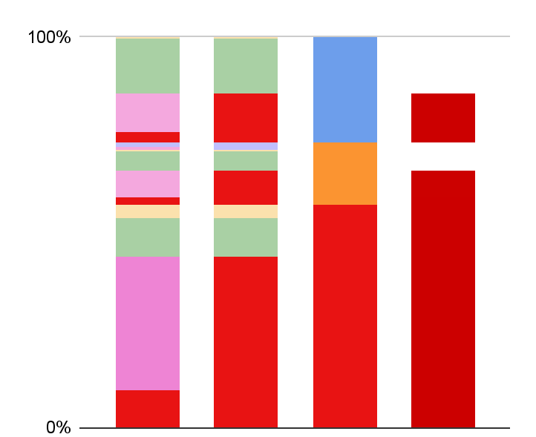
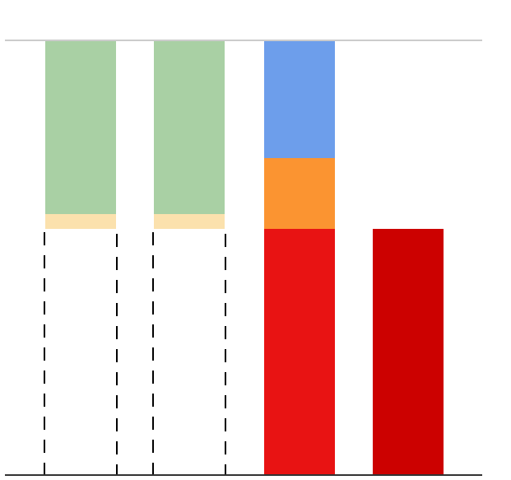
e) Base (Proportional) Case - NMC
f) Optimistic (Minimum) Case - NMC
Li Mining:
+0% CHN
Li Refining: +23% CHN
NMC Cath.:
57% CHN
Total: 80% CHN
Li Mining:
+0% CHN
Li Refining: +0% CHN
NMC Cath.: 57% CHN
Total: 57% CHN
CHL
CHL
KOR
CHL
CHL
KOR
CHN
JAP
CHL
CHL
JAP
CHN
NMC-Li
CHL
Supply that involves CHN
CHN
CHN
AUS
Supply that involves CHN
CHN
CHN

Slide 15
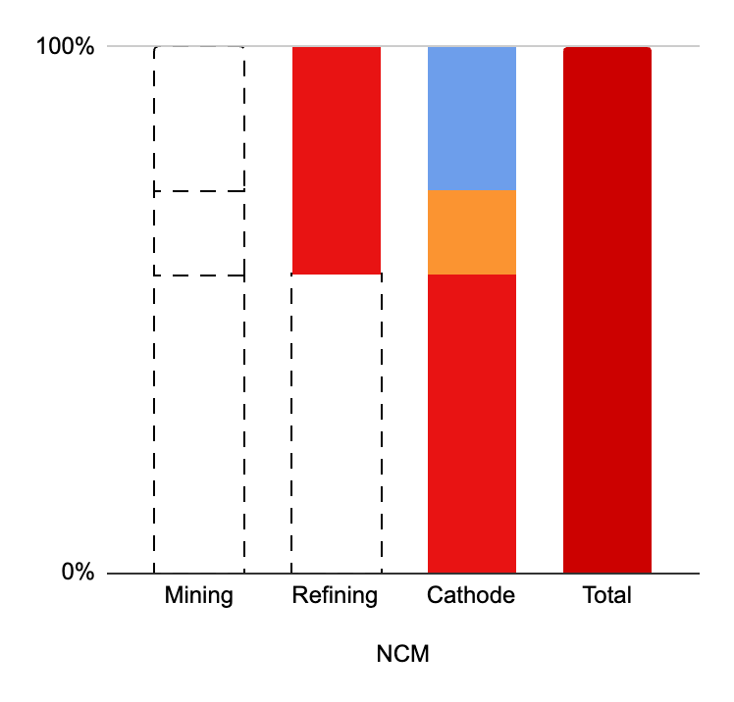
g) Pessimistic (Maximum) Cases - NMC†
Total
China (CHN)
Canada (CAN)
USA
South Korea (KOR)
Unobserved and Indirect Trade
Production irrelevant to total level of CHN involvement
Japan (JAP)
Chile (CHL)
Argentina (ARG)
Australia (AUS)
Li Mining:
+0% CHN
Li Refining: +43% CHN
NMC Cath.:
57% CHN
Total: 100% CHN
KOR
JAP
Supply that involves CHN
* Observed direct trade only
** All Observed and non-observed trade
† Both NMC maximum cases
have the same numerical index
value, though the underlying
distribution could vary
CHN

Slide 16
China
Japan
South Korea
USA
Canada
Chile
Argentina
Australia
Unobserved and Indirect Trade
Upstream production and trade hidden by downstream vulnerability
China
USA
Canada
Chile
Argentina
Australia
Unobserved and Indirect Trade
Upstream production and trade hidden by downstream vulnerability

Slide 17
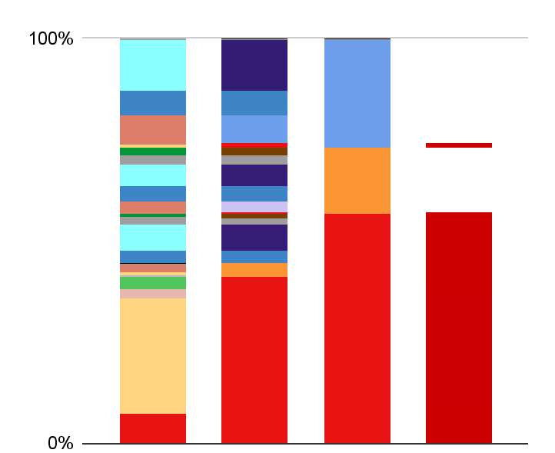
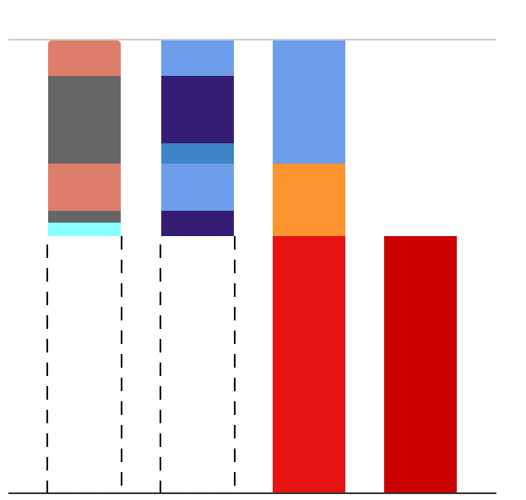
Base (Proportional) Case - NMC-Ni
Optimistic (Minimum) Case - NMC-Ni
Ni Mining:
+0% CHN
Ni Refining: +2% CHN
NMC Cath.: 57% CHN
Total: 58% CHN
Ni Mining:
+0% CHN
Ni Refining: +0% CHN
NMC Cath.: 57% CHN
Total: 57% CHN
CAN
FIN
NCL
KOR
NOR
KOR
UIT
FIN
KOR
NCL
KOR
NOR
JAP
NCL
KOR
JAP
NMC-Ni
FIN
CAN
Supply that involves CHN
CHN
Supply that involves CHN
CHN
PHL
CHN
CHN

Slide 18
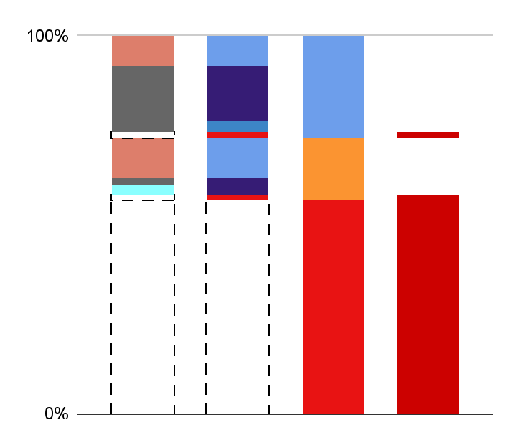
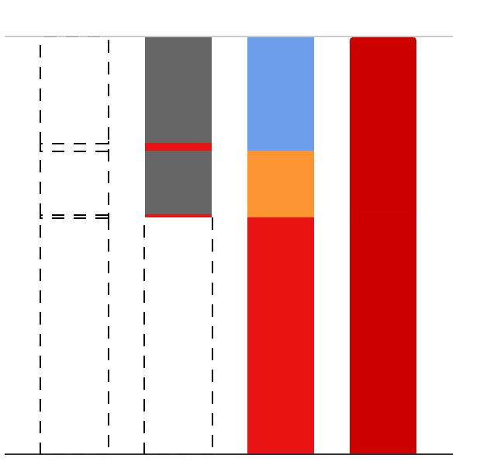
Pessimistic (Maximum) Case A - NMC-Ni Observed direct trade only
Pessimistic (Maximum) Case B - NMC-Ni All observed and non-observed trade
Ni Mining:
+0% CHN
Ni Refining: +2% CHN
NMC Cath.: 57% CHN
Total: 59% CHN
Ni Mining:
+0% CHN
Ni Refining: +43% CHN
NMC Cath.: 57% CHN
Total: 100% CHN
NCL
KOR
UNC
FIN
KOR
UIT
KOR
NCL
KOR
JAP
UIT
JAP
FIN
Supply that could involve CHN
Supply that involves CHN
CHN
CHN

Slide 19
Total
China (CHN)
Canada (CAN)
USA
South Korea (KOR)
Japan (JAP)
Australia (AUS)
Finland (FIN)
New Caledonia (NCL)
Philippines (PHL)
Brazil
United Kingdom
Indonesia
South Africa
Unobserved and
Indirect Trade (UIT)
Production irrelevant
to total level of CHN
involvement

Slide 20
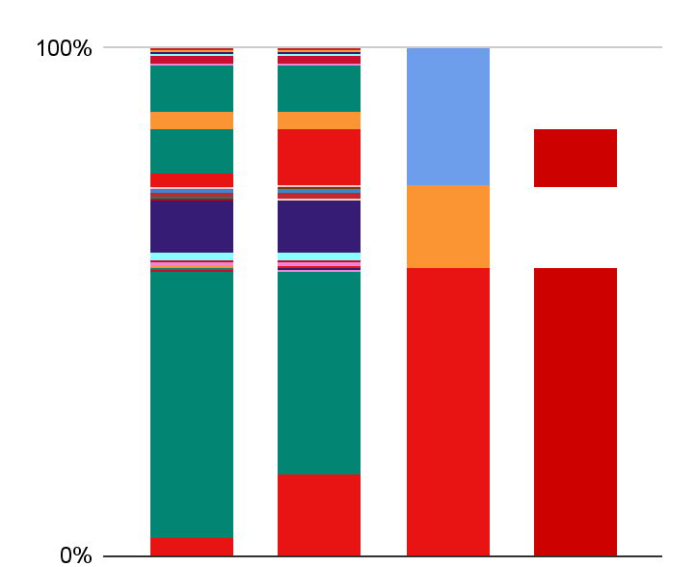
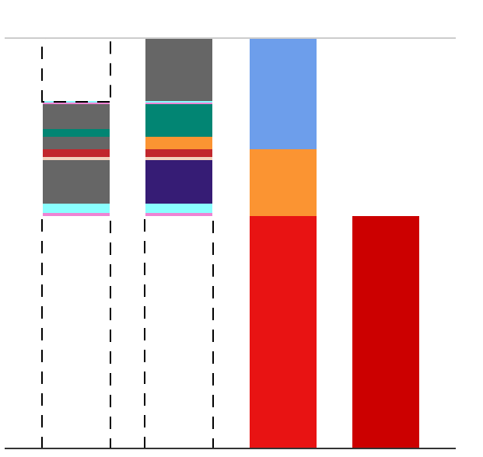
Base (Proportional) Case - NMC-Co
Optimistic (Minimum) Case - NMC-Co
Co Mining:
+0% CHN
Co Refining: +13% CHN
NMC Cath.: 57% CHN
Total: 70% CHN
Co Mining:
+0% CHN
Co Refining: +0% CHN
NMC Cath.: 57% CHN
Total: 57% CHN
DRC
DRC
UIT
JAP
JAP
KOR
KOR
DRC
CHN
DRC
JAP
FIN
FIN
JAP
UIT
FIN
JAP
NMC-Co
DRC
DRC
CHN
Supply that involves CHN
Supply that involves CHN
CHN
DRC

Slide 21
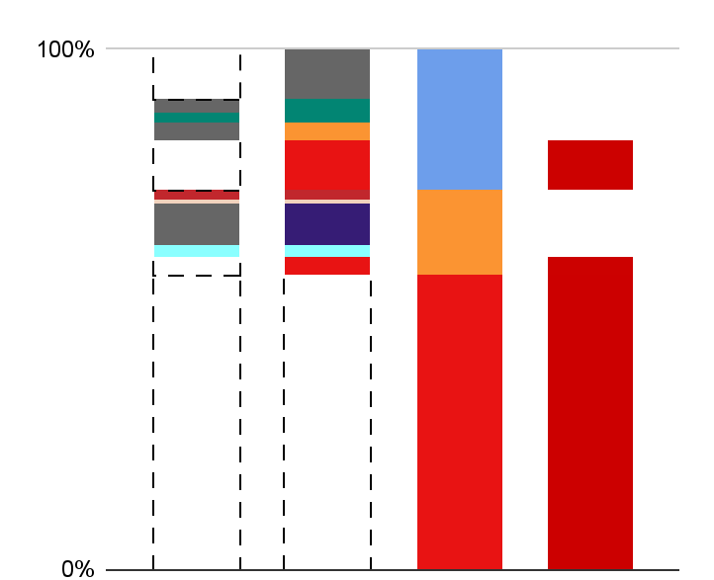
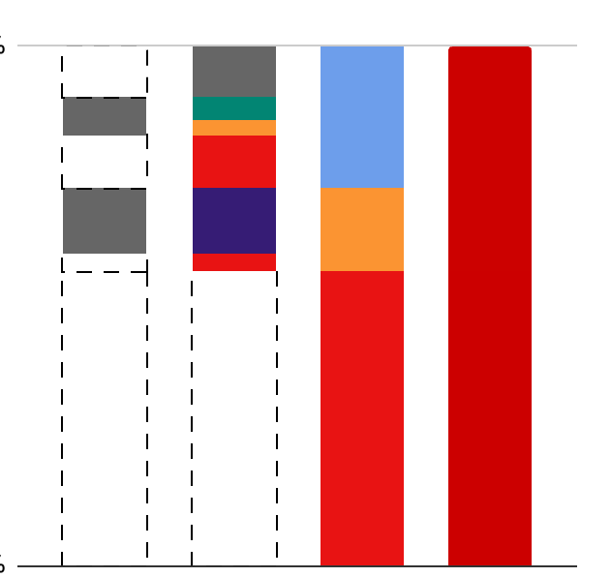
Pessimistic (Maximum) Case A - NMC-Co Observed direct trade only
Pessimistic (Maximum) Case B - NMC-Co All observed and non-observed trade
Co Mining:
+0% CHN
Co Refining: +13% CHN
NMC Cath.: 57% CHN
Total: 70% CHN
Co Mining:
+21% CHN
Co Refining: +23% CHN
NMC Cath.: 57% CHN
Total: 100% CHN
UIT
UIT
DRC
KOR
DRC
KOR
CHN
CHN
UIT
FIN
JAP
UIT
FIN
JAP
CHN
Supply that could involve CHN
Supply that involves CHN
CHN
CHN

Slide 22
Total
China (CHN)
Canada (CAN)
South Korea (KOR)
Japan (JAP)
India
Finland (FIN)
Belgium
Australia
Democratic Republic of the Congo (DRC)
Zambia
Norway
Morocco
Madagascar
Unobserved and
Indirect Trade (UIT)
Production irrelevant
to total level of CHN
involvement

Slide 23
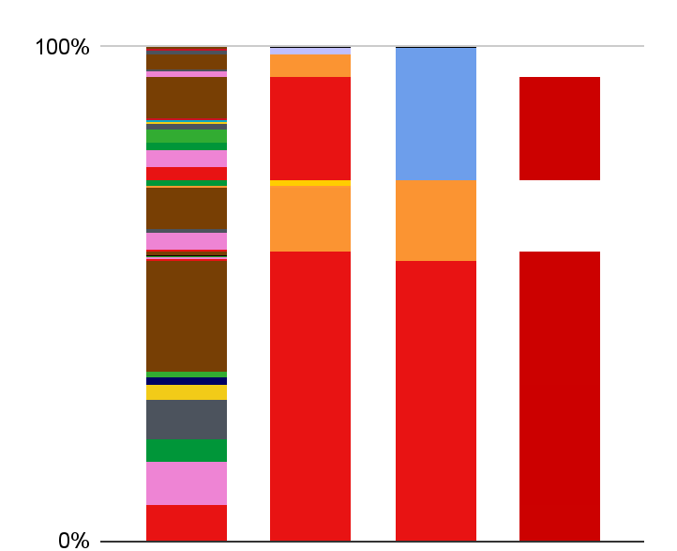
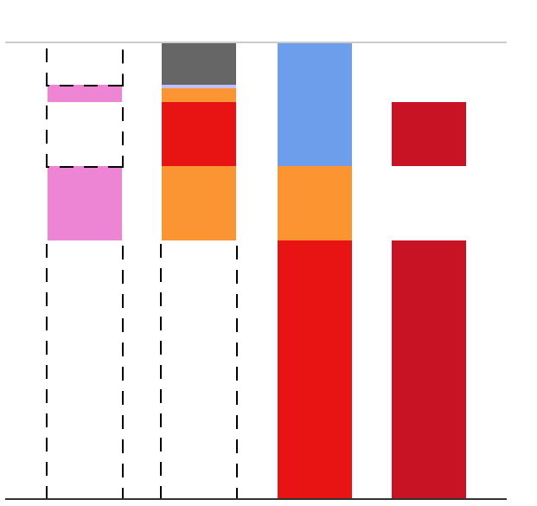
Base (Proportional) Case - NMC-Mn
Optimistic (Minimum) Case - NMC-Mn
Mn Mining:
+0% CHN
Mn Refining: +23% CHN
NMC Cath.: 57% CHN
Total: 80% CHN
Mn Mining:
+0% CHN
Mn Refining: +14% CHN
NMC Cath.: 57% CHN
Total: 71% CHN
UIT
ZAF
CHN
KOR
KOR
CHN
ZAF
JAP
JAP
AUS
JAP
JAP
NMC-Mn
ZAF
CHN
Supply that involves CHN
Supply that involves CHN
GAB
CHN
CHN
AUS
CHN

Slide 24
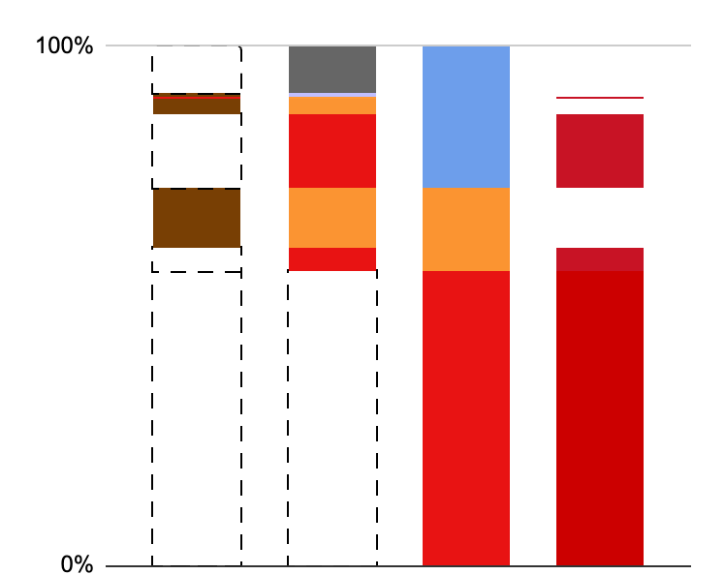
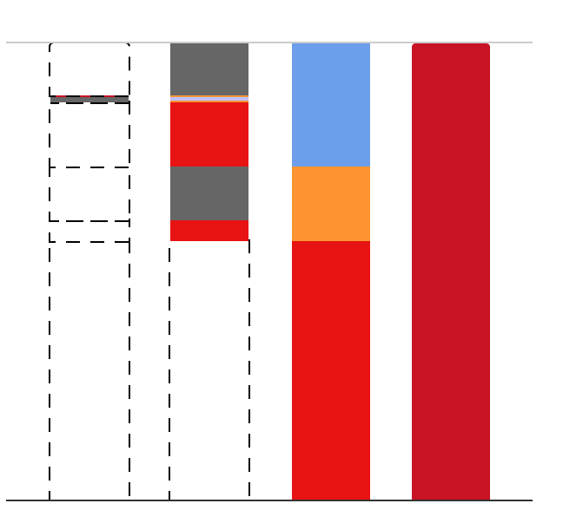
Pessimistic (Maximum) Case A - NMC-Mn Observed direct trade only
Pessimistic (Maximum) Case B - NMC-Mn All observed and non-observed trade
Mn Mining:
+0% CHN
Mn Refining: +19% CHN
NMC Cath.: 57% CHN
Total: 76% CHN
Mn Mining:
+2% CHN
Mn Refining: +41% CHN
NMC Cath.: 57% CHN
Total: 100% CHN
UIT
UIT
KOR
KOR
CHN
CHN
ZAF
JAP
JAP
UIT
JAP
Supply that could involve CHN
Supply that involves CHN
CHN
CHN

Slide 25
Total
China (CHN)
Canada (CAN)
USA
South Korea (KOR)
Japan (JAP)
Australia (AUS)
Brazil
Colombia
Gabon (GAB)
Ghana
India
Kazakhstan
Malaysia
Mexico
Myanmar
South Africa (ZAF)
Ukraine
Unobserved and
Indirect Trade (UIT)
Production irrelevant
to total level of CHN
involvement

Slide 26
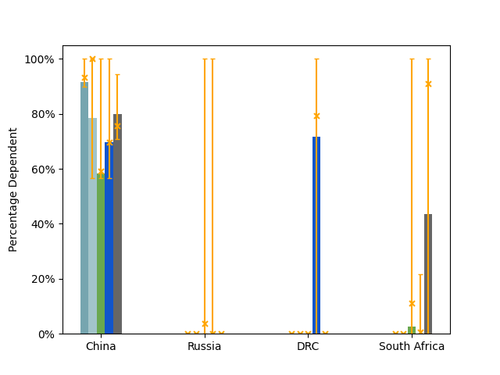

Slide 27
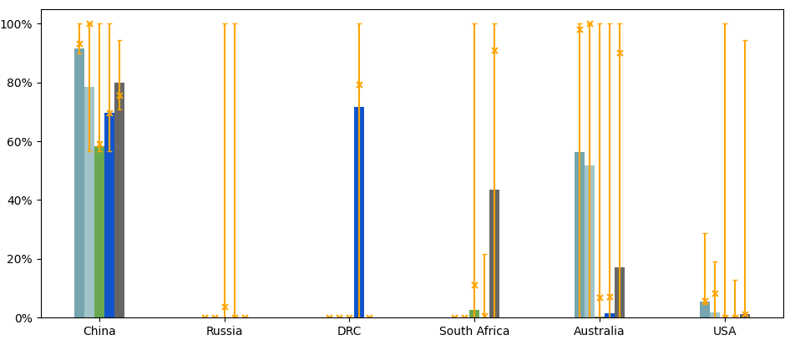

Slide 28
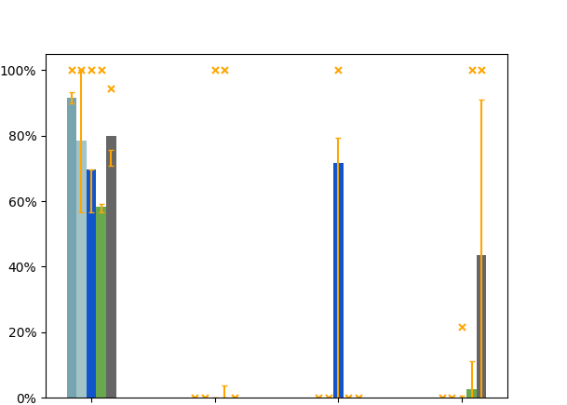
Total vulnerability of cathode production
China
Russia
DRC
South Africa

Slide 29
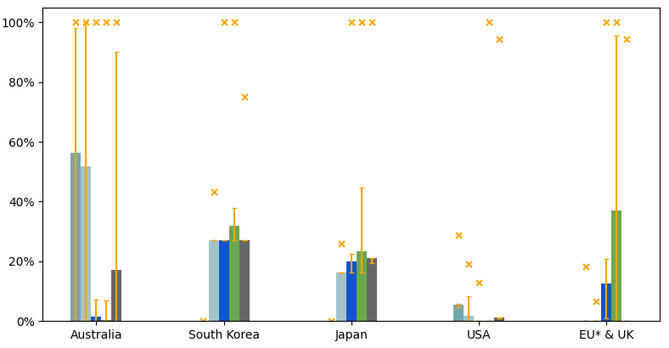
Total vulnerability of cathode production

Slide 30
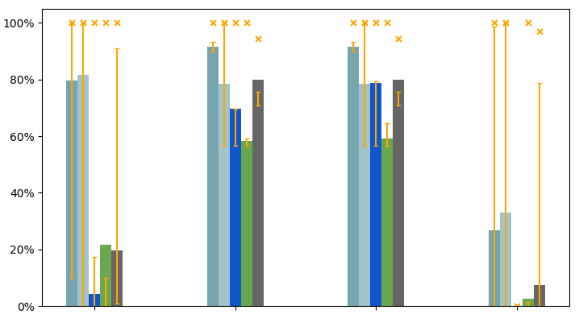
Total vulnerability of cathode production
USA and USA Free Trade Countries
China and Chinese company- owned Ni & Co bloc (DRC, Indonesia, Philippines)
South American Li bloc (Chile, Argentina, Bolivia, Brazil, Peru)
China and Russia

Slide 31
LFP-Li
NMC-Li
NMC-Ni
NMC-Co
NMC-Mn
LFP-Li
NMC-Li
NMC-Co
NMC-Ni
NMC-Mn

Slide 32
Trade Data, with Conversion Factors
Total Demand (Demand + Exports) = Total Supply (Production + Imports)
Production Data, with Conversion Factors

